Slide 1
CIS 4930/6930-002 Data Visualization
SINGLE VIEW, MULTIVIEW, & FOCUS+CONTEXT
Paul Rosen
Assistant Professor
University of South Florida
slides credits Miriah Meyer (U of Utah)

Slide 2
Single vs Multiple views
eyes over memory—trade-off of display space and working memory
similar situation with partitioning vs layering

Slide 3
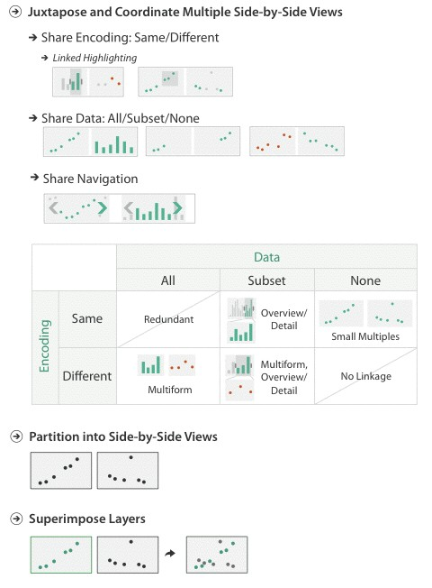
A variety of options…

Slide 4
LINKED VIEWS
multiple views that are simultaneously visible and linked together such that actions in one view affect the others

Slide 5
What to show
encoding: same or multiform
dataset: share all, subset, or none
How to interact
highlighting: to link, or not
navigation: to share, or not

Slide 6
MULTIFORM
different visual encodings are used between the views
rational: single, monolithic view has strong limits on the number of attributes that can be shown simultaneously

Slide 7
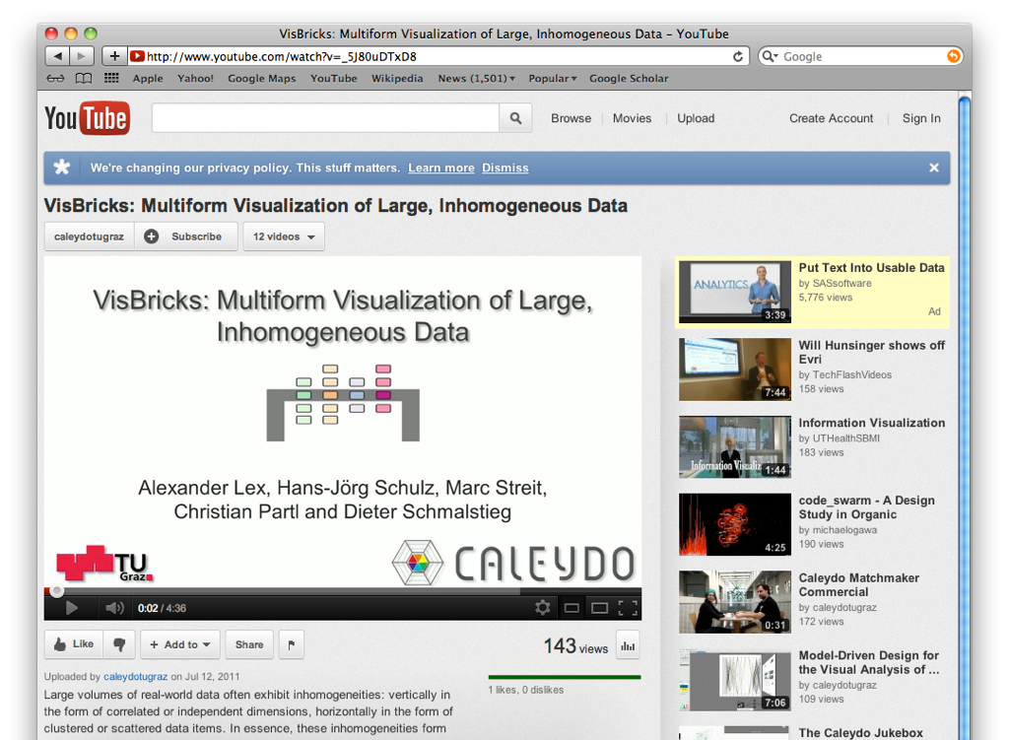
https://www.youtube.com/watch?v=_5J80uDTxD8

Slide 8
What to show
encoding: same or multiform
dataset: share all, subset, or none
How to interact
highlighting: to link, or not
navigation: to share, or not

Slide 9
SHARED DATA
showing all data in each view, but with different encoding schemes
rational: different views support different tasks

Slide 10
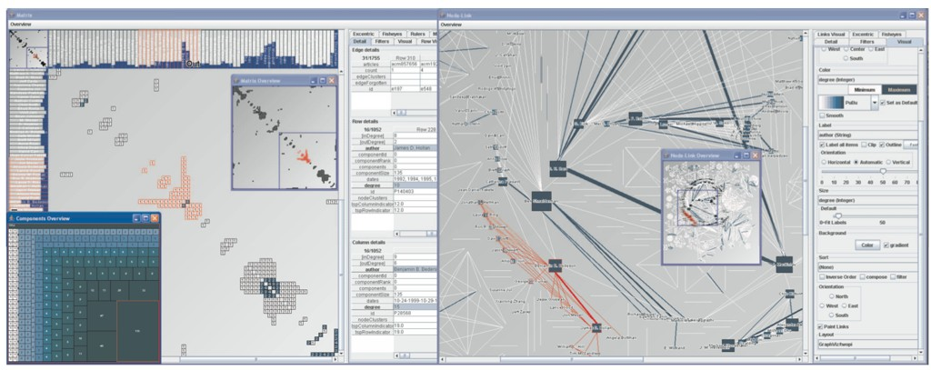
MatrixExplorer
Henry 2006

Slide 11
OVERVIEW + DETAIL
one view shows (often summarized) information about entire dataset, while additional view(s) shows more detailed information about a subset of the data
rational: for large or complex data, a single view of the entire dataset cannot capture fine details

Slide 12
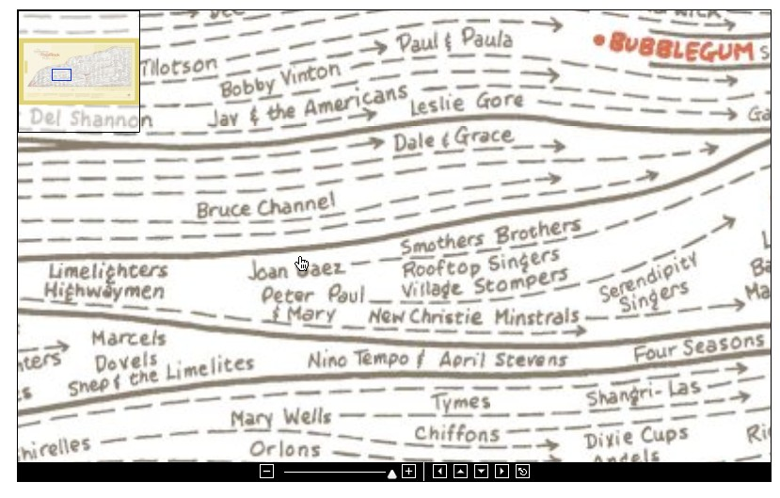

Slide 13
SMALL MULTIPLES
each view uses the same visual encoding, but shows a different subset of the data
rational: quickly compare different parts of a data set, relying on eyes instead of memory

Slide 14
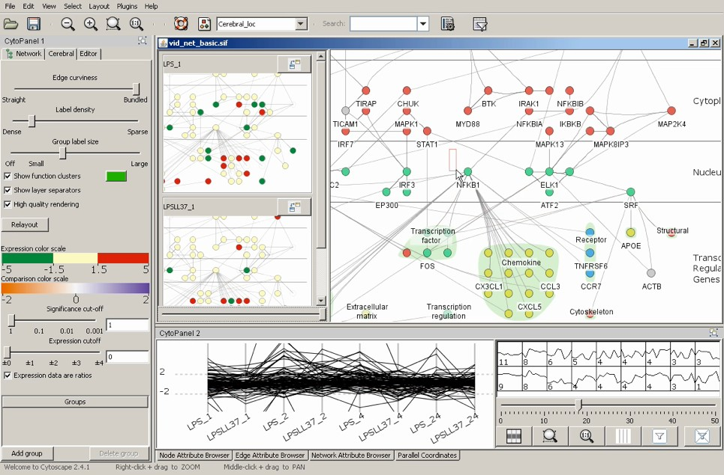

Slide 15
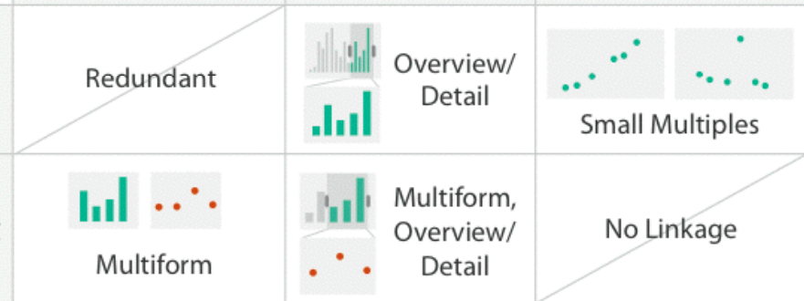
 |  | Shared Data
 |  | All | Subset | None
Shared Encoding | Same
 | Different

Slide 16
What to show
encoding: same or multiform
dataset: share all, subset, or none
How to interact
highlighting: to link, or not
navigation: to share, or not

Slide 17
LINKED HIGHLIGHTING

Slide 18
What to show
encoding: same or multiform
dataset: share all, subset, or none
How to interact
highlighting: to link, or not
navigation: to share, or not

Slide 19
LINKED NAVIGATION
http://www.historyshots.com/rockmusic/

Slide 20
A variety of options…

Slide 21
PARTITIONING
action on the dataset that separates the data into groups
main design choices
how to divide data up between views, given a hierarchy of attributes
how many splits, and order of splits how many views (usually data driven)
partition attribute(s)
typically categorical

Slide 22
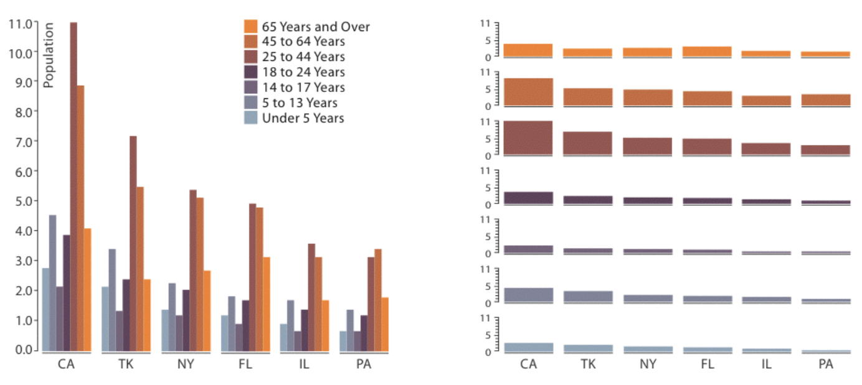

Slide 23
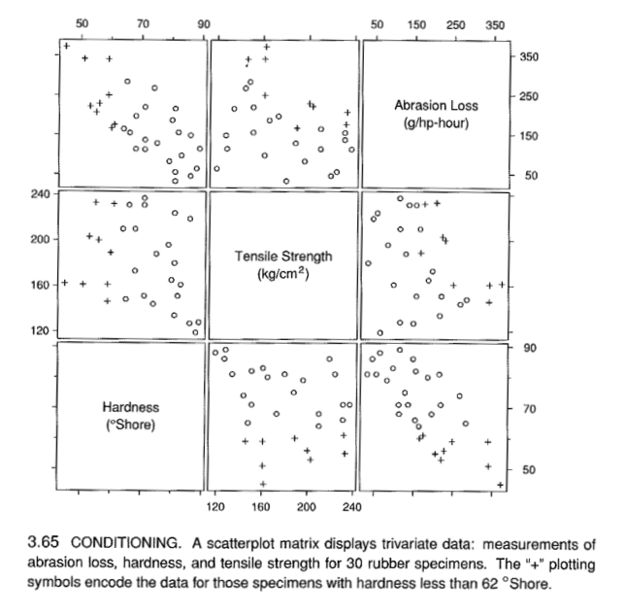
SCATTERPLOT MATRIX (SPLOM)
Cleveland 1994

Slide 24
TRELLISED VIEWS
panel variables: attributes encoded in individual views
partitioning variables: partitioning attributes assigned to columns, rows, and pages
Becker 1996

Slide 25
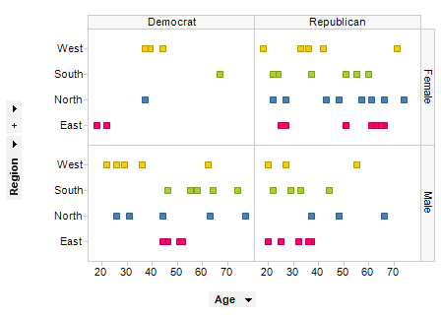
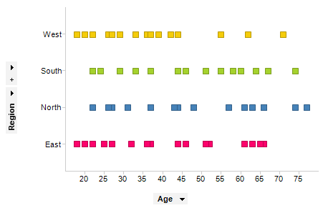
trellising this visualization based on Gender and Political affiliation
non-trellised scatter plot
https://docs.tibco.com/pub/spotfire/5.5.0-march-2013/UsersGuide/vis/vis_trellis_visualizations.htm

Slide 26
HiVE: Hierarchical Visual Expression
partitioning: transform data attributes into a hierarchy
reconfigure hierarchies to explore data space
treemaps used as spacefilling layouts
Slingsby 2009

Slide 27
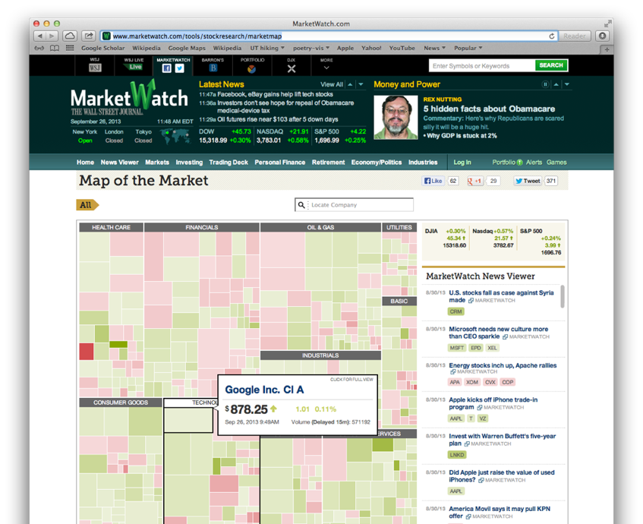
TREEMAP

Slide 28
A variety of options…

Slide 29
LAYERING
combining multiple views on top of one another to form a composite view
rational: supports a larger, more detailed view than using multiple views
trade-off: layering imposes constraints on visual encoding choice as well as number of layers that can be shown

Slide 30
GLOBAL COMPOSITING

Slide 31
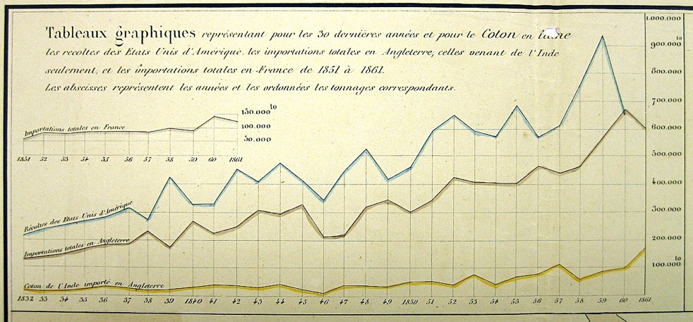
JOSEPH MINARD
1781-1870

Slide 32
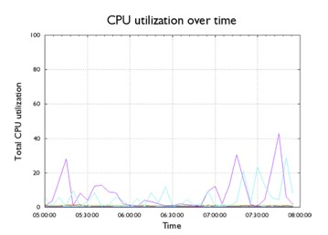
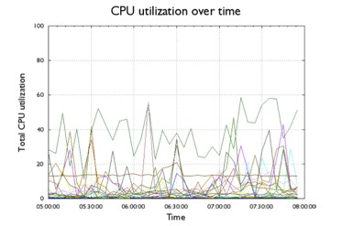
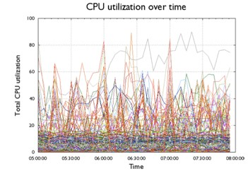
overlays

Slide 33
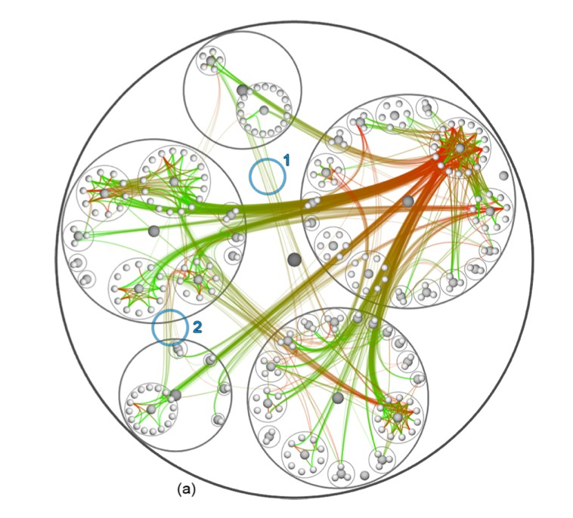
edge bundling
Holton 2006

Slide 34
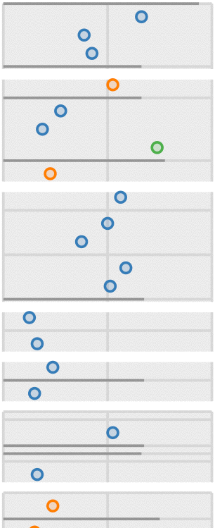
multiple encodings

Slide 35
GLYPHS
a graphical object with internal structure that arises from multiple marks
ambiguity: little distinct line between glyph and view!

Slide 36
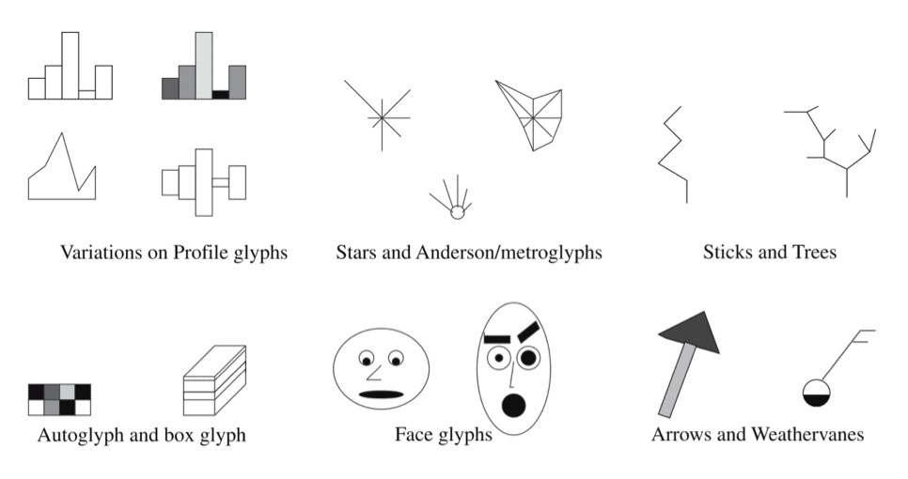

Slide 37
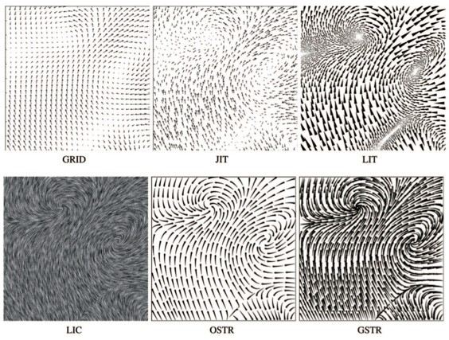
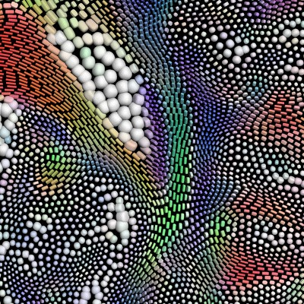
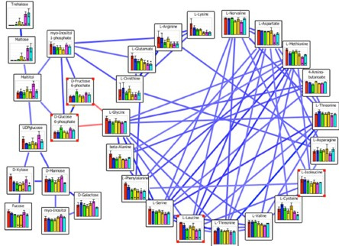
Kindlmann 2006
Junker 2006

Slide 38
Process
gather metadata for obtaining a set of names
or, things you want to represent
build a taxonomy
propose several categorization schemes
develop visual design
determine order of visual channels
propose optional mappings
identify metaphoric abstractions
implement a glyph-based system

Slide 39
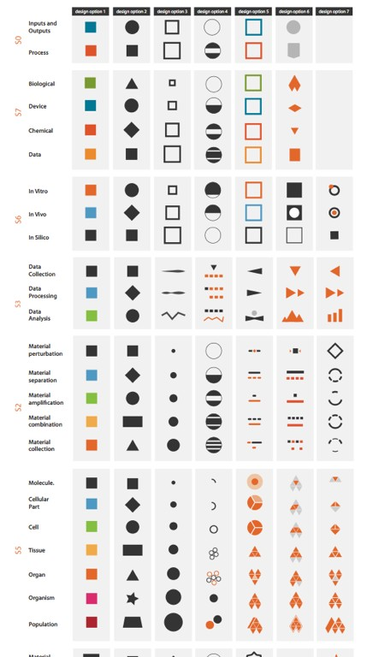

Slide 40
ITEM-LEVEL STACKING

Slide 41
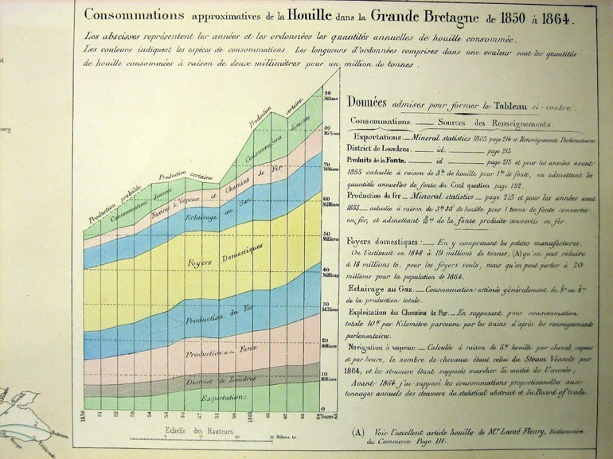
1781-1870
JOSEPH MINARD

Slide 42
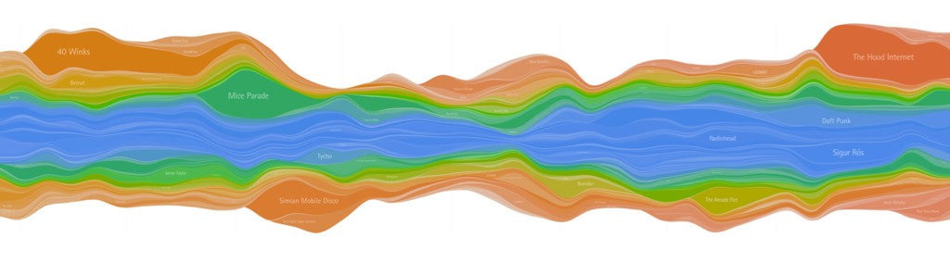
streamgraph
Byron 2008

Slide 43
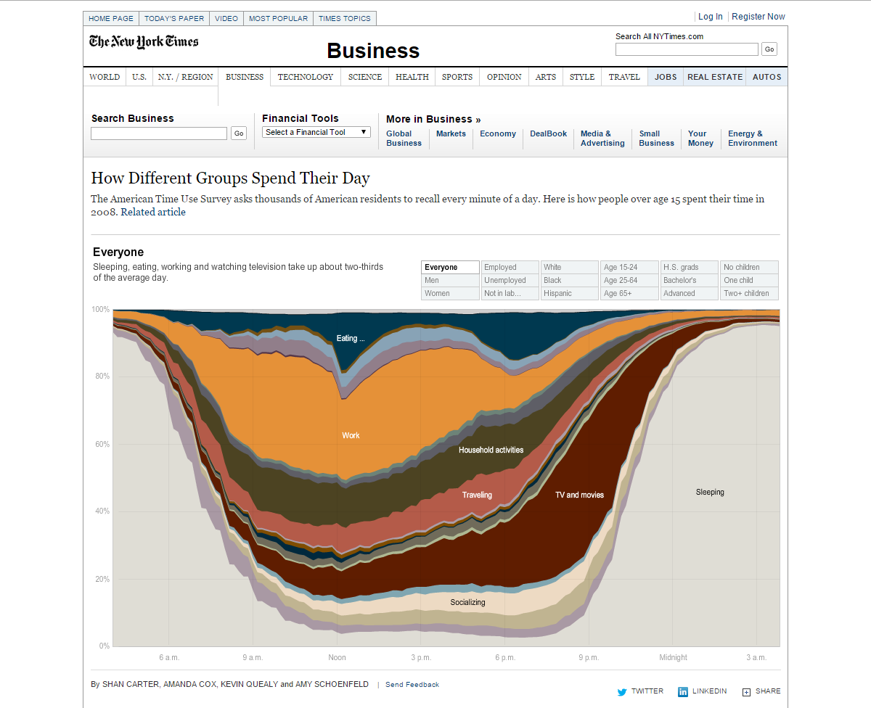
http://www.nytimes.com/interactive/2009/07/31/business/20080801-metrics-graphic.html?_r=0

Slide 44
FOCUS + CONTEXT
techniques to show detail (focus) and overview (context) simultaneously
requires: carefully pick what to show and hinting at what you are not showing

Slide 45
FOCUS + CONTEXT
synthesis of visual encoding and interaction
user selects region of interest (focus) through navigation or selection
provide context through aggregation, reduction, or layering

Slide 46
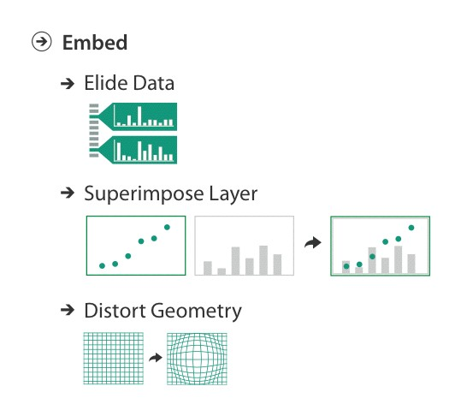
focus+context

Slide 47
elision
means “suppression”
focus items shown in detail, other items summarized (suppressed) for context

Slide 48
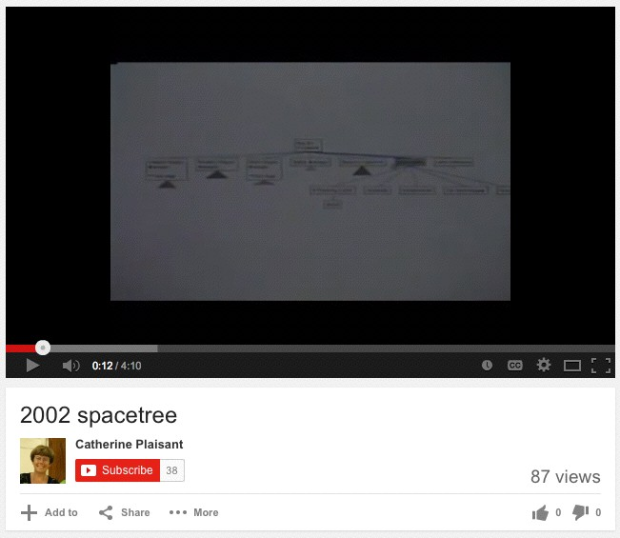
SpaceTree
Grosjean 2002

Slide 49
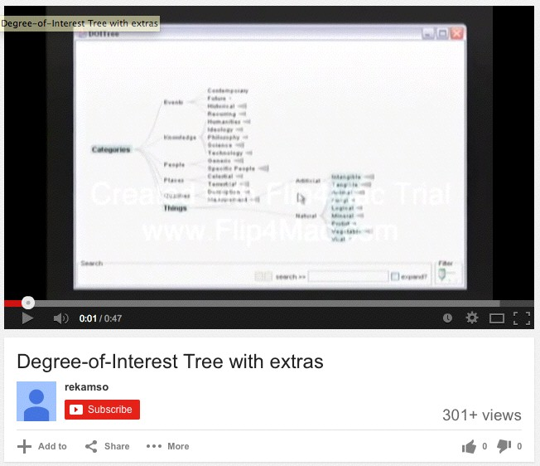
DOITree
Heer 2004

Slide 50
DOI
degree of interest
based on observation that humans often represent their own neighborhood in detail, yet only major landmarks far away
goal is balance between local detail and global context
Furnas 1986

Slide 51
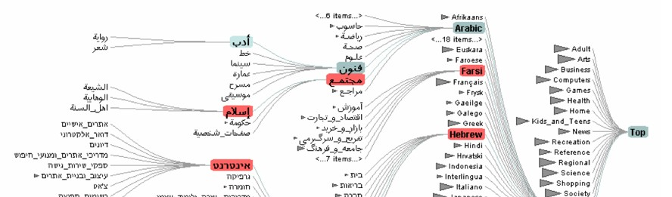
DOITree
interactive trees with animated transitions that fit within a bounded region of space
layout depends on the user’s estimated DOI
use...
logical filtering based on DOI
geometric distortion of node size based on DOI
semantic zooming on content based on node size
aggregate representations of elided subtrees
Heer 2004

Slide 52
superimpose
focus layer limited to a local region of view, instead of stretching across the entire view

Slide 53
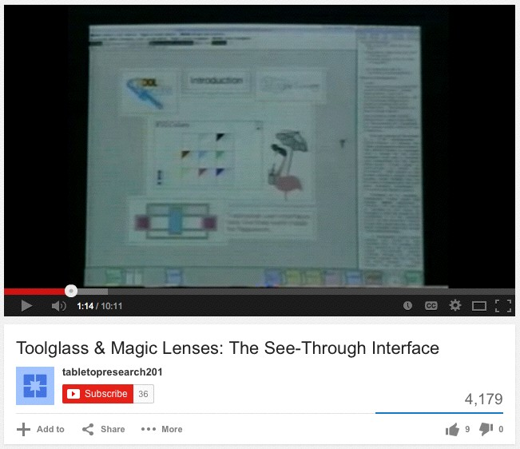
Toolglass & Magic Lenses

Slide 54
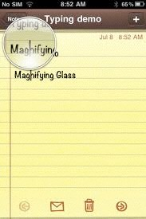
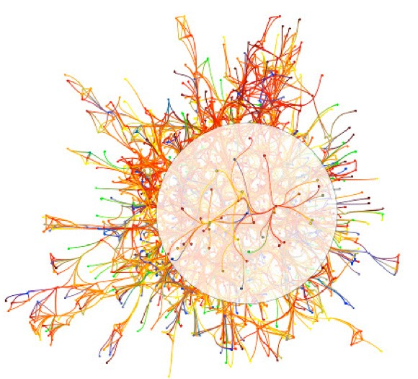
magnification
highlight | suppress

Slide 55
distort
use geometric distortion of the contextual regions to make room for the details in the focus region(s)

Slide 56
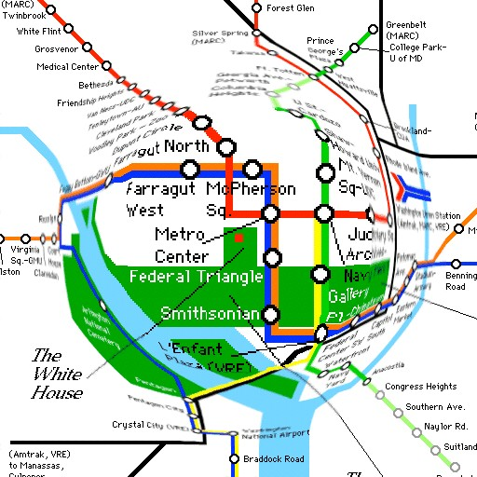
FISHEYE
http://www.cs.umd.edu/class/fall2002/cmsc838s/tichi/fisheye.html

Slide 57
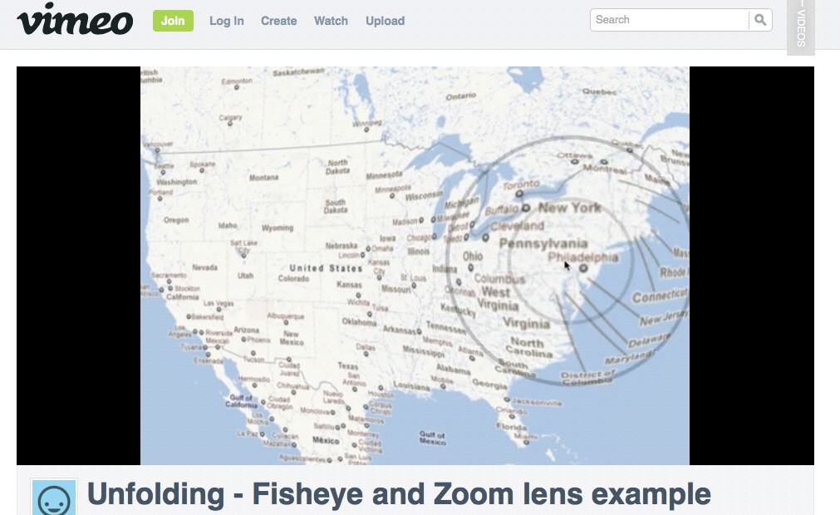

Slide 58
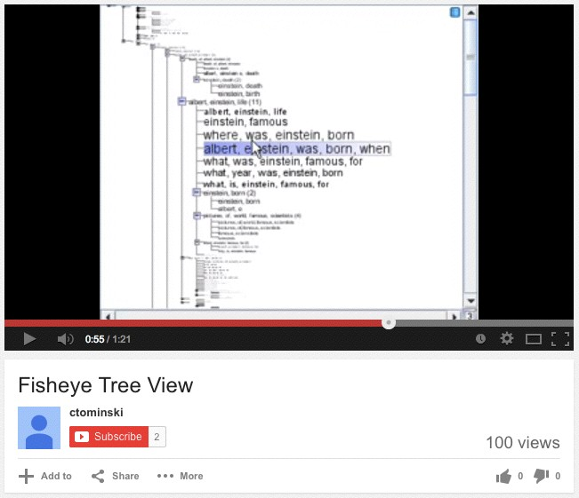

Slide 59
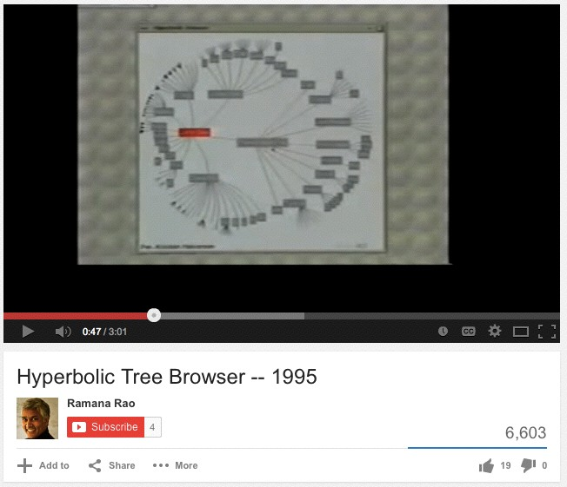
hyperbolic geometry

Slide 60
distortion concerns
unsuitable for relative spatial judgments
overhead of tracking distortion
visual communication of distortion
(use gridlines, shading, etc.)

Slide 61
distortion concerns (cont.)
target acquisition problem
lens displacing items away from screen location
mixed results compared to separate views and temporal navigation
fisheye follow-up: concern with enthusiasm over distortion
what is being shown: selective filtering
how it is being shown: distortion as one possibility

Slide 62
Recommended Reading
Visualization Analysis & Design: Chapter 11 (pp. 242-263), Chapter 12 (pp. 264-297), & Chapter 14 (pp. 322-339)

